Slide 1

Network Layer: IPv4 Static Routing
Lecture 12 | Part 1 | CSE421 – Computer Networks
Department of Computer Science and Engineering School of Data & Science

Slide 2
Objectives
Routing
Static Routing
Standard Static Routing
Summary Static Routing
Default Static Routing
Floating Static Routing
Directly attached/connected
Next Hop/Recursive
Fully Specified
Configuration and Verification
Dynamic Routing
RIP
OSPF

Slide 3
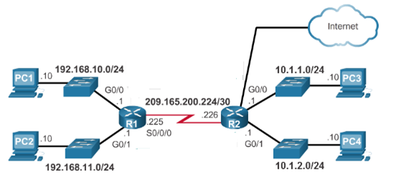
Learning About Networks

Slide 4
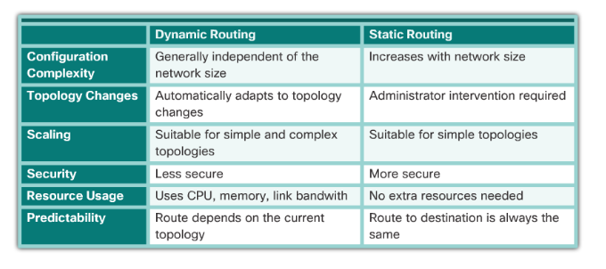
Learning About Remote Networks
A router can learn about remote networks in one of two ways:
Manually - Remote networks are manually entered into the route table using static routes.
Dynamically - Remote routes are automatically learned using a dynamic routing protocol.

Slide 5
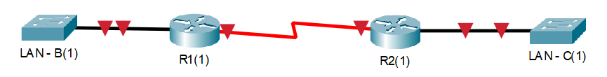
Standard Static Routing
Creating connections to specific remote networks.
All static routes have a cost of “0” because we manually configure all routes. There’s no need for the router to calculate/decide anything
Has a default Administrative Distance (AD) of “1”
Administrative Distance is the measure of trustworthiness of a link
Lower is better
Used by the Floating Static Route and Dynamic Routing Protocols
Configuring this router

Slide 6
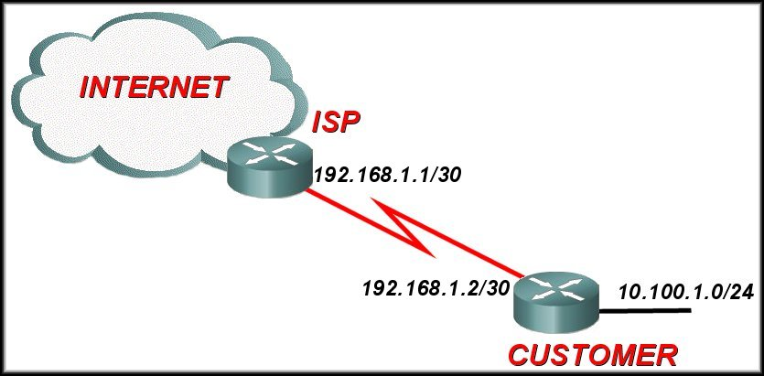
Default Static Routing
A default path for all IP packets that the router does not have a learned or static route to send them
Uses a special network address as destination: 0.0.0.0/0
Has a subnet mask of 0. Meaning, it will check zero bits and hence it will match all IPs!
Conventionally, always points towards the border/ISP Router.

Slide 7
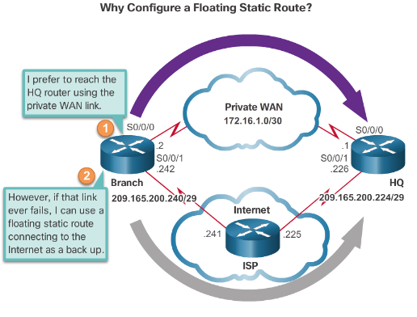
Floating Static Routing
Create a backup route in case a primary route link fails
Uses Administrative Distance (AD)
The primary path has the default AD of 1 (but, may be configured to have a higher value)
The value of AD of back up path is greater than the AD of primary path/route.
Since the AD of primary path is lower, it means that primary path is more trustworthy and hence ignore the back up path unless the primary path is down.
The static route “floats” and is not used when the route with the better administrative distance is active.
If the preferred route is lost the floating static route can take over

Slide 8
Network Layer: IPv4 Static Routing
Lecture 12 | Part 2 | CSE421 – Computer Networks
Department of Computer Science and Engineering School of Data & Science

Slide 9
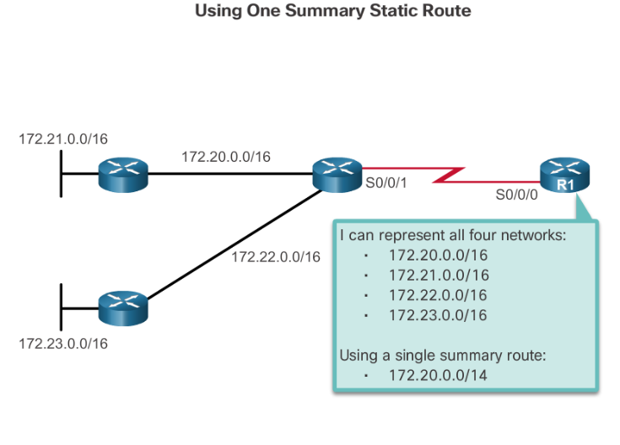
Summary Static Routing
A summary route is a single route that can be used to represent multiple routes.
Generally a set of contiguous networks.
Have the same exit interface or next-hop IP address.
Creates smaller routing tables
More efficient routing table lookup process.
Reduce the number of routes advertise

Slide 10
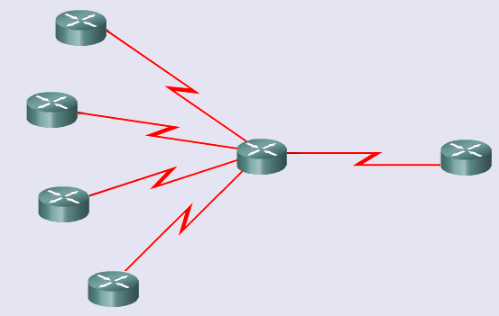
Route Summarization
How many entries does Router A have in it’s routing table?
201.1.0.0/22
201.1.4.0/23
Advertise all 4?
Router A
201.1.6.0/24
201.1.7.0/24

Slide 11
Route Summarization
Octet 3 in binary
00000000 00000100 00000110 00000111
201.1.0.0/22
201.1.4.0/23
201.1.6.0/24
201.1.7.0/24
Same
Difference starts here
Same
Difference starts in this octet (Octet 3)
201.1.00000000.0/21
21 bits the same so use /21 for summary

Slide 12
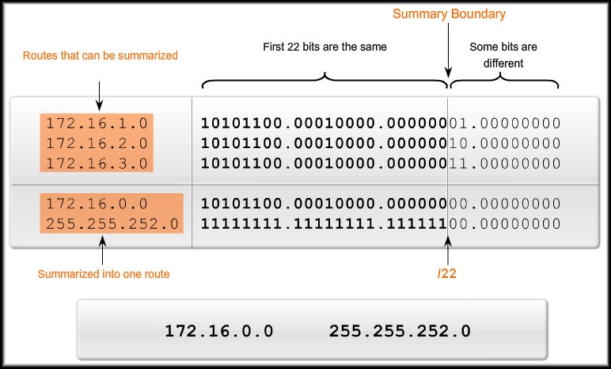
Route Summarization Another Example

Slide 13
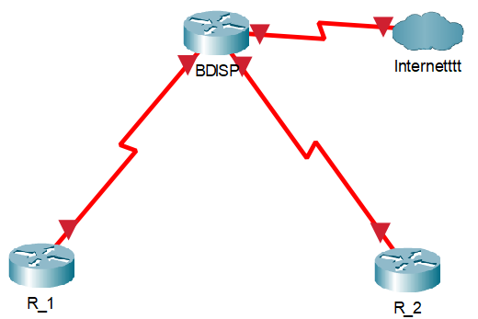
Problem of Summary Static Routing
192.16.0.0/22
192.16.0.0/22
192.16.0.0/24
192.16.2.0/24
192.16.1.0/24
192.16.3.0/24
Discontiguous Networks

Slide 14
Next Hop Options
Directly attached/connected static route
Only the router exit interface/port name (i.e. s0/0) is specified.
Next-hop/Recursive lookup static route
Only the next-hop IP address (i.e. 2.2.2.2) is specified.
Fully specified static route
The next-hop IP address and exit interface (i.e. s0/0 2.2.2.2) are specified.
**Note: Port labels:
Each port has a name (s0/0 or f0/0 or g0/0 or etc.) and an IP address (1.2.3.4 or etc.)
.1
2.2.2.0/30
.2
S0/0
S0/1
**Configuring R1(1) towards LAN – C
***All settings are done from R1(1)’s perspective

Slide 15
Network Layer: IPv4 Static Routing
Lecture 12 | Part 3 | CSE421 – Computer Networks
Department of Computer Science and Engineering School of Data & Science

Slide 16
Configuration

Slide 17
Static Route Command
ip route [dest. net. add.] [dest. net. s/m] [exit option] [AD]
Destination Network Address: Destination network address (can be summarized as well) of the remote network to be added to the routing table of the router
Destination Network Subnet Mask: Subnet mask of the remote network that is being added to the routing table. The subnet mask can be modified to summarize a group of networks
Exit Options: Directly attached; Next-hop; Fully specified
AD (Administrative Distance): Optional field; Default value is ‘1’ if not set.
e.g. ip route 1.1.3.0 255.255.255.0 s0/1; Directly attached route (using exit-interface name)
To delete a route, just add they keyword “no” before the entire static route command.
e.g. no ip route 1.1.3.0 255.255.255.0 s0/1;
**Note: Most Cisco commands can be reversed like this

Slide 18
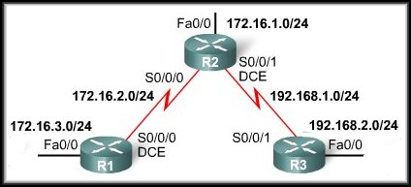
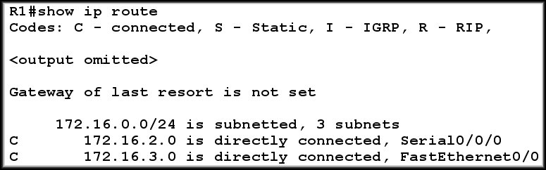
Static Route Configuration
A router, by default, knows of its directly connected networks only.

Slide 19
Adding a Static Route using Next Hop IP
The command to add a static route on R1 towards LAN of R2 using Next-Hop IP.
Variants of the same command:
ip route 172.16.1.0 255.255.255.0 S0/0/0 -> Directly attached
ip route 172.16.1.0 255.255.255.0 S0/0/0 172.16.2.2 -> Fully Specified
The 2nd command is not recommended for point-to-point links/interfaces
172.16.2.2 / 24
172.16.2.1 / 24

Slide 20
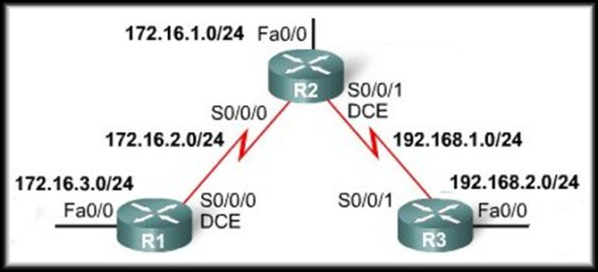
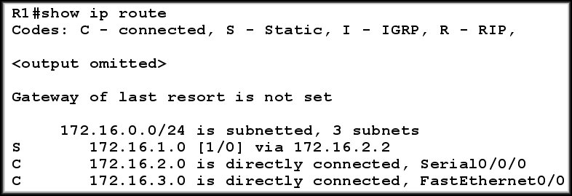
After adding the static route…
BEFORE
AFTER
Would a ‘ping’ from a PC on the LAN on R1 to a PC on the LAN on R2 work?

Slide 21
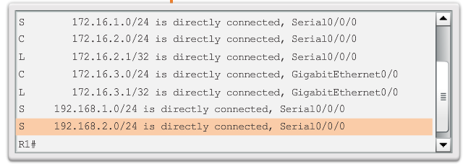
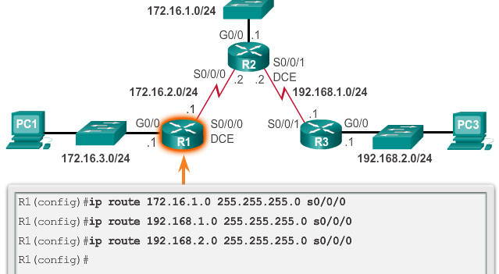
Example of Static Route using Exit Interface

Slide 22
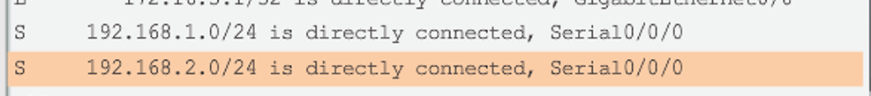
Static Route : The line explained
Type of route:
S - Static
Destination Network
Cost of Path
Next Hop IP
Or, Exit Interface
Or, Fully Specified
Administrative
Distance
Static Routing table record if it was configured with Exit Interface

Slide 23

Configuring R2 and R3

Slide 24
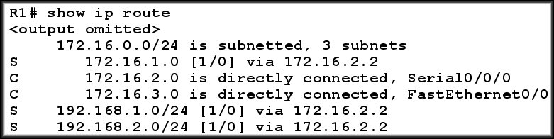
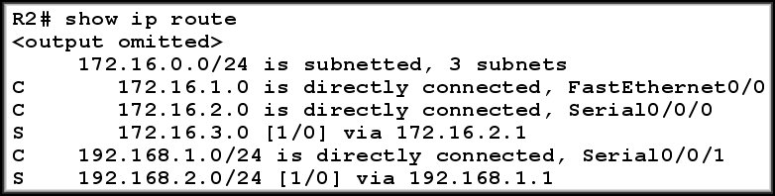
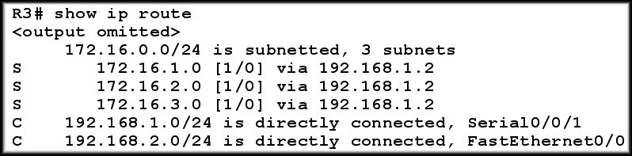
Verifying Next Hop Static Routes

Slide 25
The Disadvantage of using Next Hop IP
Before any packet is forwarded by a router, the routing table process must determine the exit interface to use to forward the packet.
When the router has to perform multiple lookups in the routing table before forwarding a packet, it is performing a process known as a Recursive Route Lookup.

Slide 26
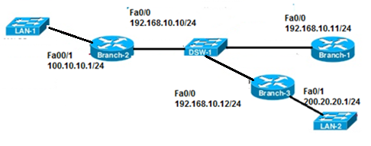
Configuring a Fully Specified Static Route
Both the output interface and the next-hop IP address are specified.
It’s used when the output interface is a multi-access interface and it is necessary to explicitly identify the next hop else, the Router will have difficulty determining the destination MAC address.
Network 1: 100.10.10.0/24
Network 2: 192.168.10.0/24
Network 3: 200.20.20.0/24
Branch-2(config)#ip route 200.20.20.0 255.255.255.0 fa0/0 192.168.10.12
Recommended

Slide 27
Network Layer: IPv4 Static Routing
Lecture 12 | Part 4 | CSE421 – Computer Networks
Department of Computer Science and Engineering School of Data & Science

Slide 28
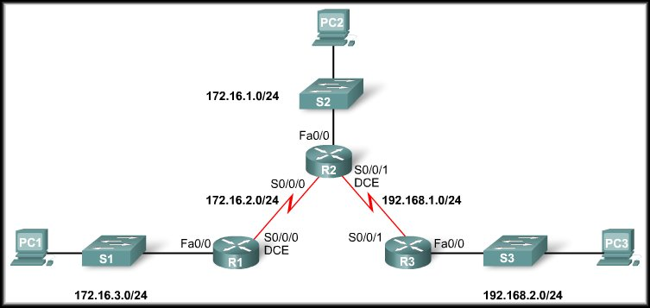
Configuring a Summary Static Route
R3 has three static routes configured.
All three routes are forwarding traffic out the same Serial 0/0/1 interface.
Can be summarized to 172.16.0.0 / 22 (255.255.252.0)

Slide 29
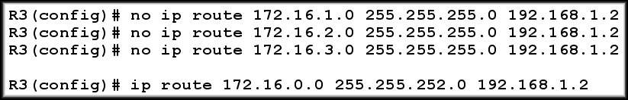
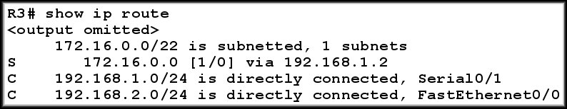
Verifying Summary Static Route
BEFORE
AFTER
Any packet with a destination IP address belonging to the 172.16.1.0/24, 172.16.2.0/24, or 172.16.3.0/24 network matches this summarized route.

Slide 30
Configuring Default Static Route
**Note: A static route usually always points towards the specific network, while default static route points towards outside the network where a border router is connected to the internet
ip route 10.100.1.0 255.255.255.0 192.168.1.2
ip route 0.0.0.0 0.0.0.0 192.168.1.1

Slide 31
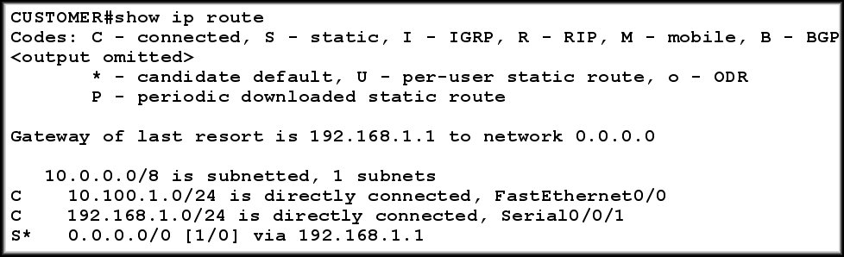
Verifying Default Static Route

Slide 32
Configuring a Floating Static Route
Branch(config)#ip route 209.165.200.224 255.255.255.240 S0/0/0
Branch(config)#ip route 209.165.200.224 255.255.255.240 S0/0/1 5
*In other words, the AD has to be more than the AD of sthe primary route.
** A primary route may be set to have other AD values
**There can be more than one back up route, or, a back up of the back up route.
AD > 1

Slide 33
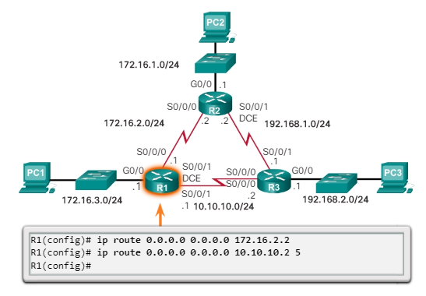
Configuring Floating Default Static Route

Slide 34
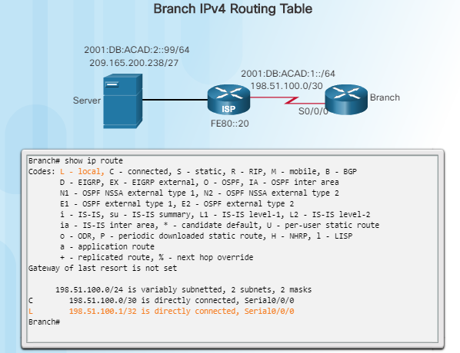
Automatically Installed Host Routes

Slide 35
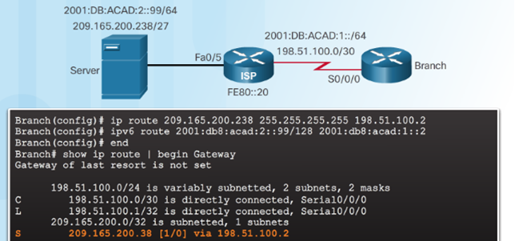
Configure IPv4 Static Host Routes

Slide 36
Commands to Verify Static Routes
Along with ping and traceroute, useful commands to verify static routes include:
show ip route
show ip route static
show ip route network

Slide 37
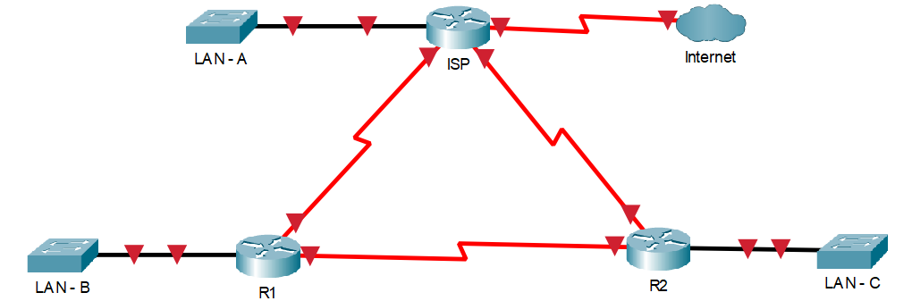
Example Network for routing
Try to configure the following on Cisco Packet Tracer
**Use the power of Google to search and find how to configure if you get stuck.
F0/1
S0/2
S0/0
S0/1
1.1.3.0/24
.1
.1
WAN - E
WAN - D
2.2.1.0/30
2.2.3.0/30
.2
.2
S0/1
1.1.2.0/24
S0/1
1.1.4.0/24
.1
.2
F0/1
S0/0
F0/0
S0/0
WAN - F
2.2.2.0/30

Slide 38
The End

